Slide 1
Telerik Backend Services
SaaS Cloud Platform Providing Database Access Through RESTful API
Telerik Software Academy
Learning & Development
http://academy.telerik.com

Slide 2
Table of Contents
Telerik Backend Services Overview
Registering an application
Creating Content Types
Getting an app key
Backend Services REST API
Users, Authentication and Content Types
JavaScript SDK
Users, Authentication and Content Types

Slide 3
Telerik Backend Services
A SaaS Cloud provider for data storage

Slide 4
Telerik Backend Services
Telerik Backend Services is a Software-as-a-Service cloud provider
Create Content Types
Get CRUD API over these types
Previously known as Telerik Everlive
Telerik Backend Services has a 30-day-long free trial

Slide 5
Telerik Backend Services: Registering an Application
To register an application:
Go to http://www.telerik.com/backend-services
Login with Telerik, Facebook, Google, Yahoo or LiveID account
Create an app
Give it name and description
Ready to go!
Once an application is created, an AppKey is generated

Slide 6
Registering an app in Telerik Backend Services
Live Demo

Slide 7
Creating Content Types

Slide 8
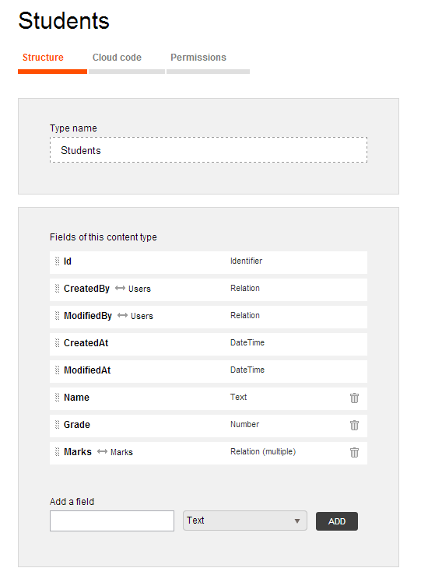
Creating Content Types
Telerik Everlive provides CRUD operations over a set of Content Types
A few built-in Content Types
An unlimited number of custom Content Types
Content Types are much like SQL tables
Yet they have different value types

Slide 9
Creating Content Types (2)
Content Types in Telerik Backend Services can have the following types of fields (types of columns)
Text (a regular string)
Number (a decimal floating-point number)
Yes / No (TRUE/FALSE, like a boolean)
File (stores either base64 encoded data or multipart/form-data)
Geopoint (keeps Latitude and Longitude)
Relation (creates a relation between two content types)

Slide 10
Creating Content Types
Live Demo

Slide 11
Backend Services REST API
CRUD operations over the created content types

Slide 12
Backend Services REST API
Once the Content Types are created, Everlive provides CRUD operations over these content types
The REST API works with JSON data
The end points for the services are as follows:
http://api.everlive.com/v1/{AppKey}/{ContentType}

Slide 13
Backend Services REST API: Example
Example for registering a user:
var user = {
"Username": "DonchoMinkov",
"Password": "123456q" };
$.ajax({
type: "POST",
url:
'https://api.everlive.com/v1/5ea2iMpkmWF5AFhW/Users',
contentType: "application/json",
data: JSON.stringify(user),
success: function(data){
alert(JSON.stringify(data));
},
error: function(error){
alert(JSON.stringify(error));
}
});

Slide 14
Backend Services REST API: Example (2)
Example for logging in a user:
var user = {
"Username": "DonchoMinkov",
"Password": "123456q" };
$.ajax({
type: "POST",
url:
'https://api.everlive.com/v1/5ea2iMpkmWF5AFhW/oauth/token',
contentType: "application/json",
data: JSON.stringify(user),
success: function(data){
alert(JSON.stringify(data));
},
error: function(error){
alert(JSON.stringify(error));
}
});

Slide 15
Backend Services REST API: Registering a User
Live Demo

Slide 16
Backend Services REST API: Getting all Users
Backend Services provide CRUD operations for all content types
For requests, different from Register/Login, the REST API needs an authentication token
Used to authenticated the users and check for their rights and restrictions
$.ajax({
url:'https://api.everlive.com/v1/5ea2iMpkmWF5AFhW/Users/',
type: "GET",
headers: {"Authorization" : "Bearer ${AccessToken}"},
success: function(data){ pring(data); },
error: function(error){ error(data); });
})

Slide 17
Getting All Users
Live Demo

Slide 18
Backend Services JavaScript SDK
Making your live easier

Slide 19
Backend Services JavaScript SDK
Backend Services have ready-to-use JavaScript SDK, that wraps the whole REST API
Downloadable from https://platform.telerik.com/#downloads
Provides a global Everlive object to work with
The Everlive.$ object
Provides all kinds of nice things to work with Telerik Backend Services
Of course there is a catch:
Some JavaScript files must be included in the correct order

Slide 20
Backend Services JavaScript SDK (2)
The following files must be included in the exact same order:
//makes HTTP AJAX requests
<script src="path/to/reqwest.min.js"></script>
//handles promise-based working
<script src="path/to/rsvp.min.js"></script>
//has a set of object extensions
<script src="path/to/underscore.min.js"></script>
//contains the JavaScript SDK over the REST API
<script src="path/to/everlive.min.js"></script>
Or use the following:
<script src="path/to/everlive.all.min.js"></script>

Slide 21
Backend Services JavaScript SDK
Live Demo

Slide 22
Telerik Backend Services
http://academy.telerik.com

